Slide 1
KJ Mart Store management System
Rushabh Gandhi-1911012
Pathik Ghugare-1911014

Slide 2
Problem Definition
Store management System is a desktop application that enables store owner to keep track of all of the products present in the store and also to handle the bills.
It also provides a platform to update the stock and keep a track on the stocks sold.
It also helps to maintain the money record of all the profits made buy the store

Slide 3
Scope of KJ Mart
User can easily add products to the database
User can generate bills.
The bills get automatically printed and saved.
The stock of products gets updated according to the quantity of the products sold.
The user gets notification for less stock of products in the store.
The user can give discounts to the special customers.
The user can easily calculate the change amount according the bill amount and the sum paid by the customer.

Slide 4



Technologies used
Backend
Database
Frontend
Python
Sqlite3
Tkinter module

Slide 5
Functionalities of KJ Mart
Add as many products to database
Update info about products as per your choice
Handle dynamic sales
Generate & save bills
Print bills
Notifies less stock in database

Slide 6
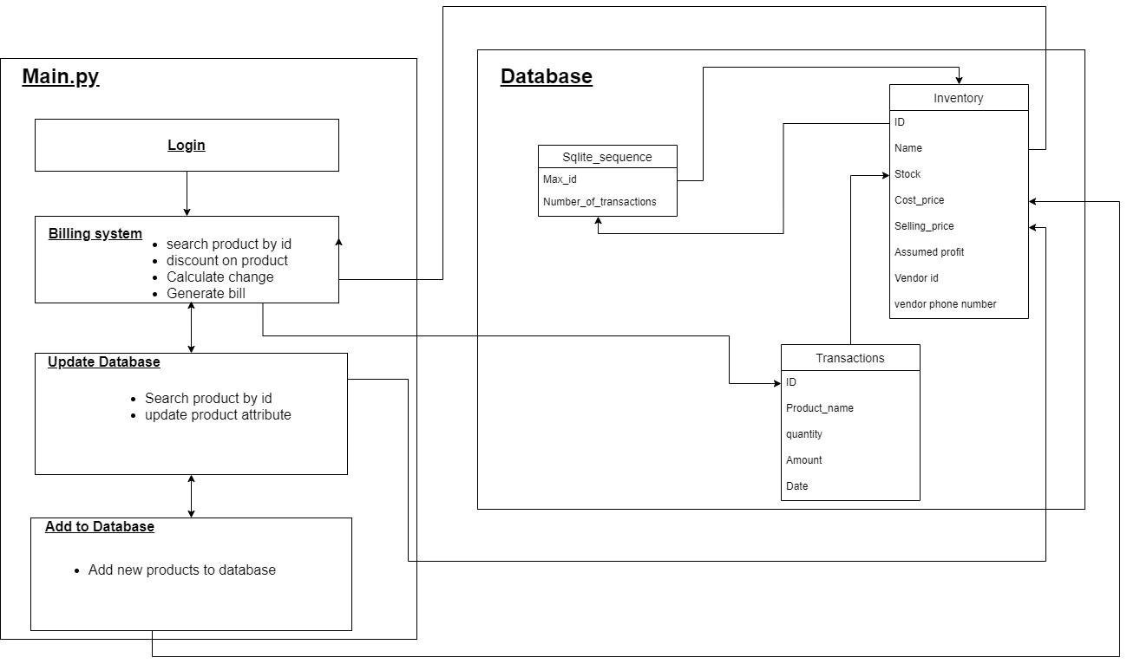
Component diagram

Slide 7
Packages & Modules Used
Tkinter module
Message box
Combo box
Frame navigations
re module
Regular expressions for checking phone number
Sqlite3 module
Database connectivity and Query handling
datetime module
To show the current date and to create subfolders for bills with respect to current date

Slide 8

Application from our learnings
Tkinter module
Regular expressions
List comprehensions
Database connectivity
File handling
Lambda functions

Slide 9
Difficulties faced and measures taken to resolve
Frame navigations :
Change method from OOP to procedural
Database connectivity
Using Os.getcwd
Combo box
Added a label specifying the value
Dynamic ID updation
Fetched ID again in the update and add to database functions
Printing bills
Created a directory for each dates

Slide 10
Teamwork
Work | Student Name
Frontend | Rushabh Gandhi & Pathik Ghugare.
UI Design | Rushabh Gandhi & Pathik Ghugare.
Database Design | Rushabh Gandhi
Database connectivity & query handling | Rushabh Gandhi
Creation of frames | Pathik Ghugare
Adding functionality to frames | Pathik Ghugare
Dynamic calculation of profit and loss | Rushabh Gandhi
Managing the bills | Rushabh Gandhi
Exception handling | Pathik Ghugare
Added product list view | Rushabh Gandhi & Pathik Ghugare.

Slide 11

References
https://docs.python.org/3/library/tkinter.html
https://www.python-course.eu/
https://stackoverflow.com/questions
https://www.tutorialspoint.com/python/
https://www.geeksforgeeks.org/python-gui-tkinter/
https://www.javatpoint.com/sqlite-tutorial
https://www.sqlite.org/index.html

Slide 12

Thank You!!

